Slide 1
Module 4: IP Security, Transport level security and Email Security
-By
Asst Prof Rohini M. Sawant

Slide 2
Introduction to IPSec
IP Security (IPSec) is a collection of protocols which is designed by Internet Engineering Task Force (IETF) to provide security for a packet at the network level.
Within the term "IPsec," "IP" stands for "Internet Protocol" and "sec" for "secure." The Internet Protocol is the main routing protocol used on the Internet; it designates where data will go using IP addresses. I
Internet Protocol Security (IPSec) is a framework of open standards for ensuring private, secure communications over Internet Protocol (IP) networks, through the use of cryptographic security services. IPSec is a suite of cryptography-based protection services and security protocols.
IP-level security encompasses three functional areas: authentication, confidentiality, and key management.
The authentication mechanism assures that a received packet was, in fact, transmitted by the party identified as the source in the packet header.
In addition, this mechanism assures that the packet has not been altered in transit. The confidentiality facility enables communicating nodes to encrypt messages to prevent eavesdropping by third parties.
The key management facility is concerned with the secure exchange of keys.

Slide 3
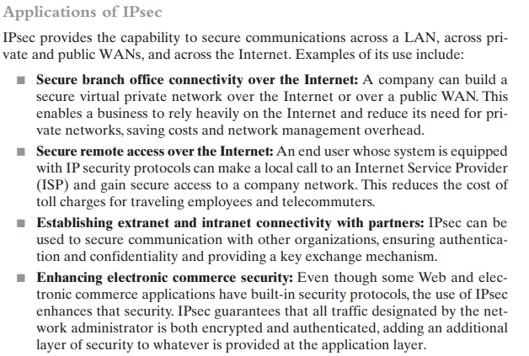

Slide 4
Some of the benefits of IPsec:
When IPsec is implemented in a firewall or router, it provides strong security that can be applied to all traffic crossing the perimeter. Traffic within a company or workgroup does not incur the overhead of security-related processing.
IPsec in a firewall is resistant to bypass if all traffic from the outside must use IP and the firewall is the only means of entrance from the Internet into the organization.
IPsec is below the transport layer (TCP, UDP) and so is transparent to applications. There is no need to change software on a user or server system when IPsec is implemented in the firewall or router. Even if IPsec is implemented in end systems, upper-layer software, including applications, is not affected.
IPsec can be transparent to end users. There is no need to train users on security mechanisms, issue keying material on a per-user basis, or revoke keying material when users leave the organization.
IPsec can provide security for individual users if needed. This is useful for offsite workers and for setting up a secure virtual subnetwork within an organization for sensitive applications.

Slide 5
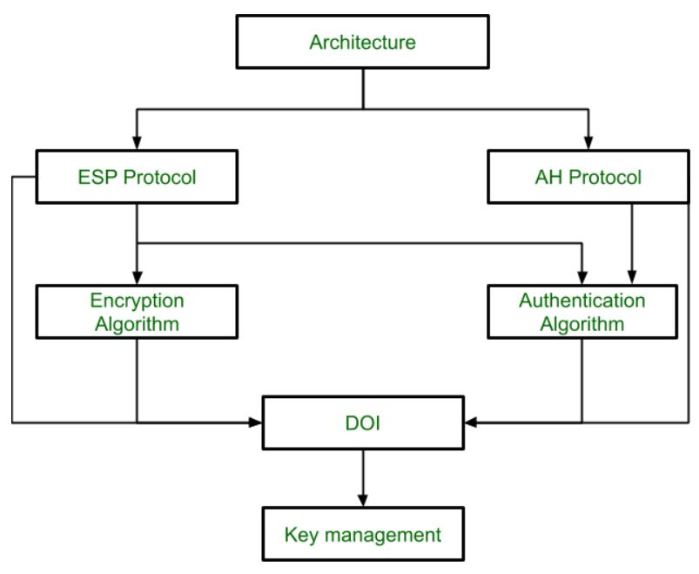
IPSEC Architetcure
ESP Protocol: ESP(Encapsulation Security Payload) provides a confidentiality service.
AH Protocol: AH (Authentication Header) Protocol provides both Authentication and Integrity service.
DOI (Domain of Interpretation): DOI is the identifier that supports both AH and ESP protocols. It contains values needed for documentation related to each other.
Key Management: Key Management contains the document that describes how the keys are exchanged between sender and receiver. (using ipseckey or Internet Key Exchange Protocol)

Slide 6
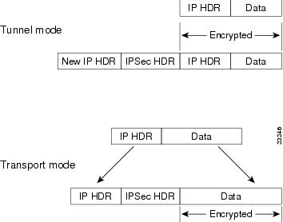
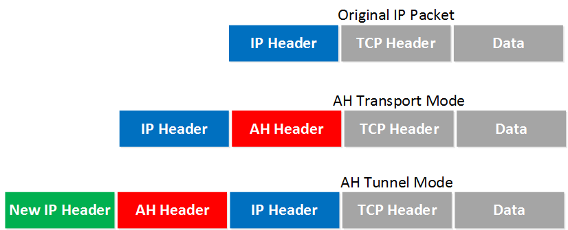
IPSEC Modes of Operation

Slide 7
IPSEC Modes of Operation
Transport Mode: In this mode, only the Payload part of Information is protected. The addressing and routing information is not protected. It is like a sealed envelope with address on it. The message inside it is protected whereas Source & Destination Address or not.
Tunnel Mode: In this mode, both the payload as well as the addressing information is protected. In this mode, the entire packet is protected and a new IP Header is added by IPSec. The original IP header information along with the payload information is protected. Tunnel Mode provides more security than the Transport Mode.

Slide 8
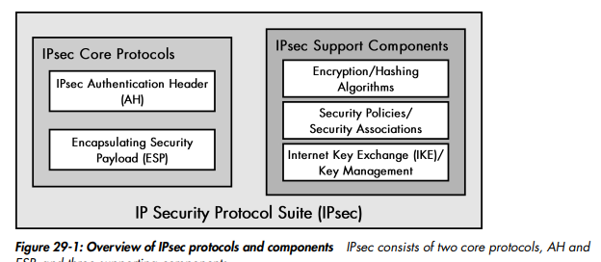
IPSEC COMPONENTS AND PROTOCOLS

Slide 9
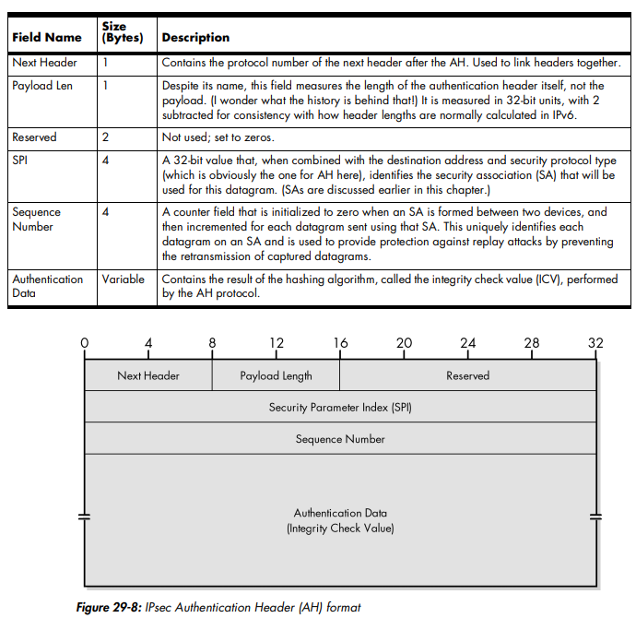
IPSec Authentication Header
This protocol provides authentication services for IPsec. It allows the recipient of a message to verify that the supposed originator of a message was actually fact the one that sent it.
It also allows the recipient to verify that intermediate devices en route haven’t changed any of the data in the datagram.
It also provides protection against so-called replay attacks, whereby a message is captured by an unauthorized user and resent.
It provides authentication of either all or part of the contents of a datagram through the addition of a header that is calculated based on the values in the datagram.

Slide 10
IPSec Authentication Header
It uses a special hashing algorithm and a specific key known only to the source and the destination.
An SA between two devices specifies these particulars, so that the source and destination know how to perform the computation but nobody else can.
On the source device, AH performs the computation and puts the result (called the integrity check value, or ICV) into a special header with other fields for transmission.
The destination device does the same calculation using the key that the two devices share. This enables the device to see immediately if any of the fields in the original datagram were modified

Slide 11
IPsec Encapsulating Security Payload (ESP)
The IPsec AH provides integrity authentication services to IPsec-capable devices so that they can verify that messages are received intact from other devices. For many applications, however, this is only one piece of the puzzle.
We want to not only protect against intermediate devices changing the datagrams, but also to protect against them examining their contents as well.
For this level of private communication, AH is not enough; we need to use the ESP protocol.
The main job of ESP is to provide the privacy we seek for IP datagrams by encrypting them.
An encryption algorithm combines the data in the datagram with a key to transform it into an encrypted form.
This is then repackaged using a special format that you will see shortly, and then transmitted to the destination, which decrypts it using the same algorithm

Slide 12
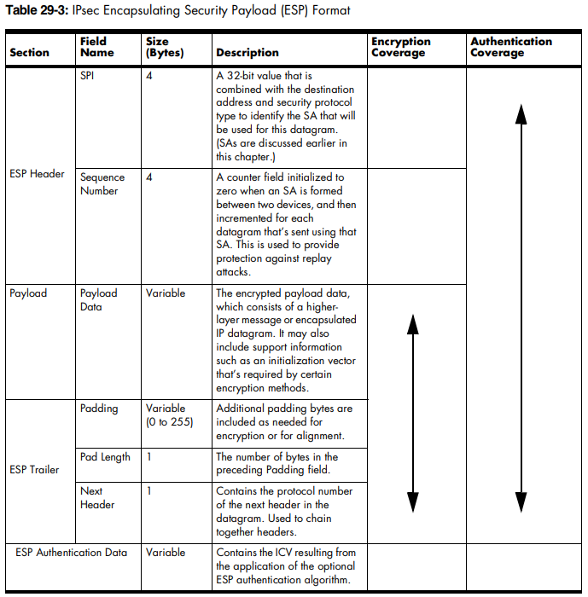
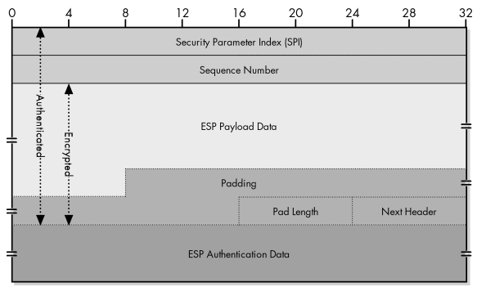

Slide 13
Internet Key Exchange (IKE) Protocol
Before either AH or ESP can be used, however, it is necessary for the two devices to exchange the secret that the security protocols themselves will use. The primary support protocol used for this purpose in IPsec is called Internet Key Exchange (IKE).
The purpose of IKE is to allow devices to exchange information that’s required for secure communication. As the title suggests, this includes cryptographic keys that are used for encoding authentication information and performing payload encryption.
IKE Policy Sets are created to negotiate several parameters, including:
The encryption algorithm (such as DES, 3DES, or AES)
The hashing algorithm (such as MD5 or SHA-1)
The authentication method (such as shared keys or RSA signatures)
The Diffie-Hellman (D-H) group for creating and sharing keys
The SA Lifetime, measured in seconds or in kilobytes sent

Slide 14
Internet Key Exchange (IKE) Protocol
There are two phases to this negotiation process:
IKE Phase 1 establishes the initial tunnel (referred to as the IKE or ISAKMP SA). Peers are authenticated, encryption and hashing algorithms are negotiated, and keys are exchanged based on the IKE Policy Sets.
Two modes can be used for Phase 1 negotiation: • Main Mode – slower, but more secure • Aggressive Mode – faster, but less secure
IKE Phase 2 establishes the IPSEC tunnel (IPSEC SA), which details the AH or ESP parameters for securing data.
These parameters are contained in an IPSEC Transform Set.
IKE Phase 1 negotiates parameters for the tunnel (key exchange) itself, while IKE Phase 2 negotiates parameters for the data traversing that tunnel.
OAKLEY Key Determination Protocol is used for establishing shared key with an assigned identifier and associated authenticated identities of the two communicating parties.

Slide 15
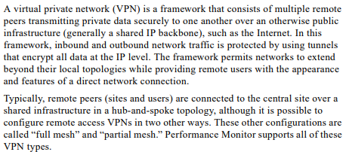
VIRTUAL PRIVATE NETWORK

Slide 16
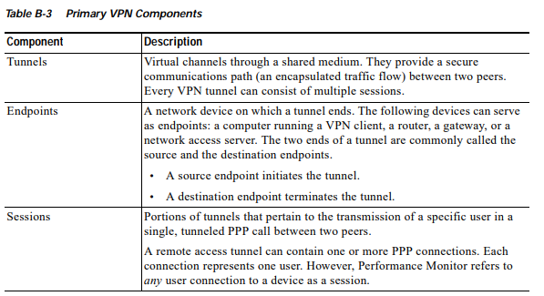

Slide 17
VPN Benefits
Secure encryption: To read the data, you need an encryption key . Without one, it would take millions of years for a computer to decipher the code in the event of a brute force attack . With the help of a VPN, your online activities are hidden even on public networks.
Disguising your whereabouts : VPN servers essentially act as your proxies on the internet. Because the demographic location data comes from a server in another country, your actual location cannot be determined. In addition, most VPN services do not store logs of your activities. Some providers, on the other hand, record your behavior, but do not pass this information on to third parties. This means that any potential record of your user behavior remains permanently hidden.
Access to regional content: Regional web content is not always accessible from everywhere. Services and websites often contain content that can only be accessed from certain parts of the world. Standard connections use local servers in the country to determine your location. This means that you cannot access content at home while traveling, and you cannot access international content from home. With VPN location spoofing , you can switch to a server to another country and effectively “change” your location.
Secure data transfer: If you work remotely, you may need to access important files on your company’s network. For security reasons, this kind of information requires a secure connection. To gain access to the network, a VPN connection is often required. VPN services connect to private servers and use encryption methods to reduce the risk of data leakage.

Slide 18
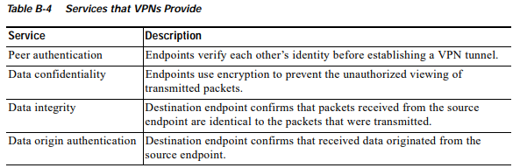
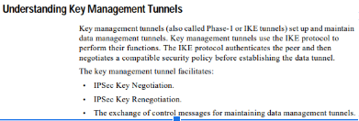

Slide 19
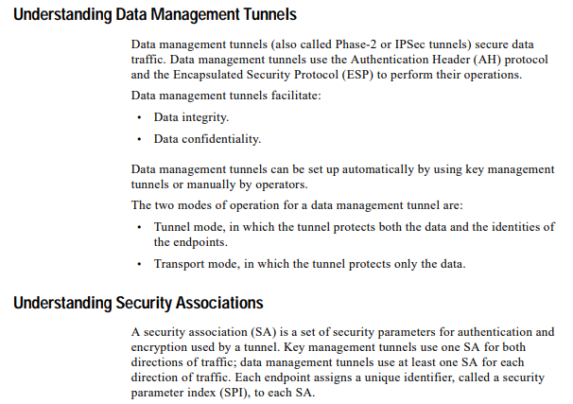

Slide 20
Secure Socket Layer
SSL, or Secure Sockets Layer, is an encryption-based Internet security protocol.
It was first developed by Netscape in 1995 for the purpose of ensuring privacy, authentication, and data integrity in Internet communications.
It resides between Application layer and Transport Layer.
SSL is the predecessor to the modern TLS encryption used today.
A website that implements SSL/TLS has "HTTPS" in its URL instead of "HTTP."
In order to provide a high degree of privacy, SSL encrypts data that is transmitted across the web. This means that anyone who tries to intercept this data will only see a garbled mix of characters that is nearly impossible to decrypt.
SSL initiates an authentication process called a handshake between two communicating devices to ensure that both devices are really who they claim to be.
SSL also digitally signs data in order to provide data integrity, verifying that the data is not tampered with before reaching its intended recipient.
Secure Socket Layer Protocols:
SSL record protocol
Handshake protocol
Change-cipher spec protocol
Alert protocol

Slide 21
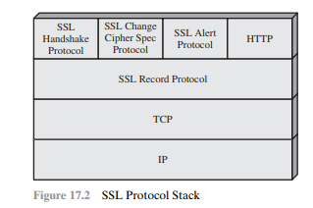
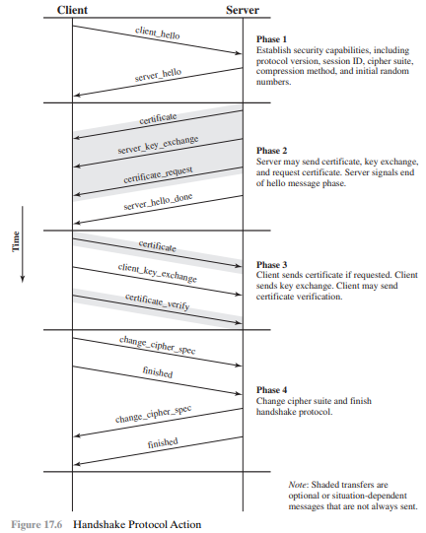

Slide 22
SSL Handshake Protocol
Handshake Protocol: Handshake Protocol is used to establish sessions. This protocol allows the client and server to authenticate each other by sending a series of messages to each other. Handshake protocol uses four phases to complete its cycle.
Phase-1: In Phase-1 both Client and Server send hello-packets to each other. In this IP session, cipher suite and protocol version are exchanged for security purposes.
Phase-2: Server sends his certificate and Server-key-exchange. The server end phase-2 by sending the Server-hello-end packet.
Phase-3: In this phase, Client replies to the server by sending his certificate and Client-exchange-key.
Phase-4: In Phase-4 Change-cipher suite occurred and after this Handshake Protocol ends.

Slide 23
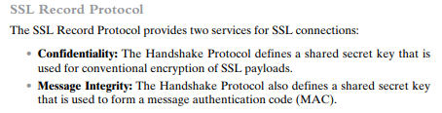
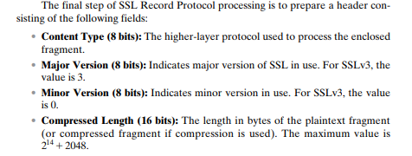
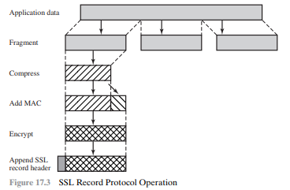
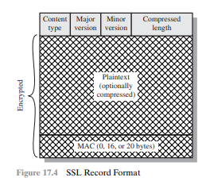

Slide 24
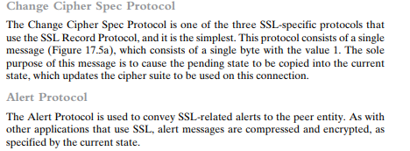
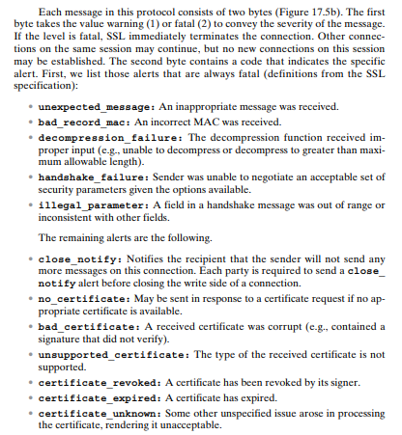
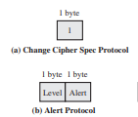

Slide 25
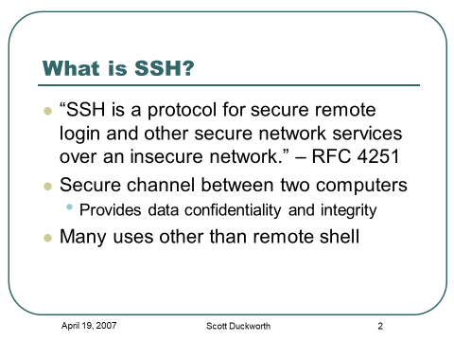
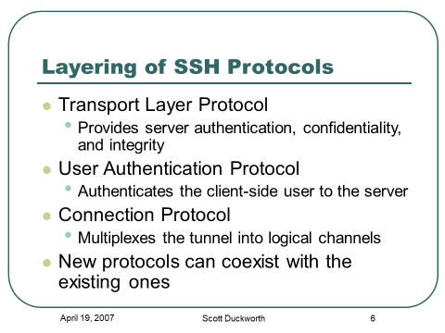

Slide 26
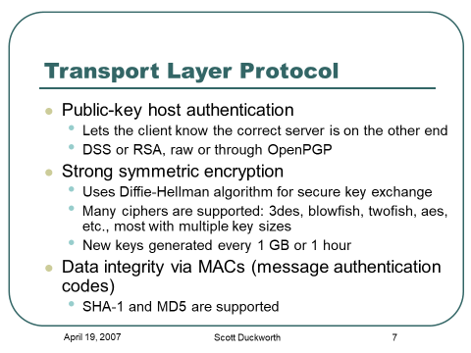
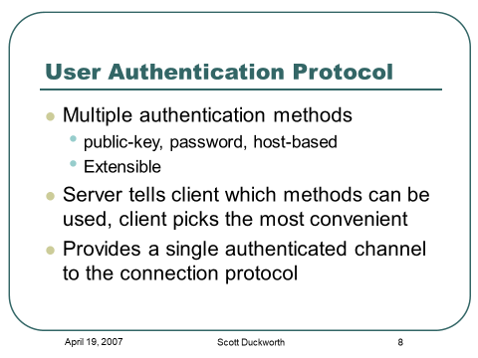

Slide 27
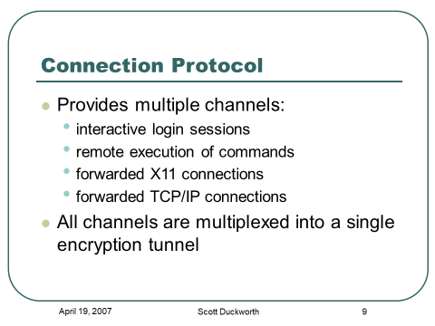
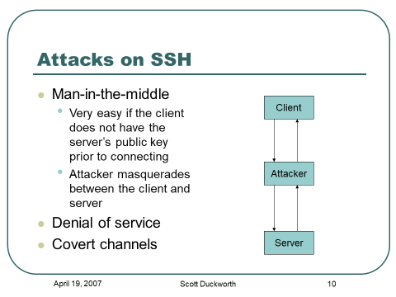

Slide 28

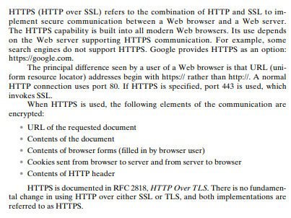
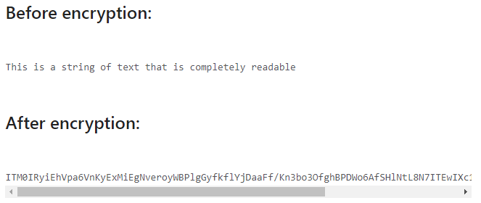
HTTPS

Slide 29
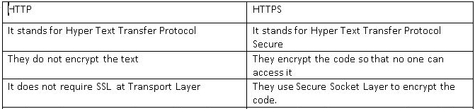
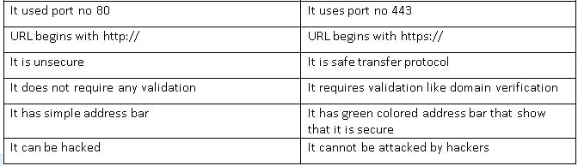

Slide 30
PGP (Pretty Good Privacy)
PGP stands for Pretty Good Privacy (PGP) which is invented by Phil Zimmermann.
PGP was designed to provide all four aspects of security, i.e., privacy, integrity, authentication, and non-repudiation in the sending of email.
PGP uses a digital signature (a combination of hashing and public key encryption) to provide integrity, authentication, and non-repudiation. PGP uses a combination of secret key encryption and public key encryption to provide privacy. Therefore, we can say that the digital signature uses one hash function, one secret key, and two private-public key pairs.
PGP is an open source and freely available software package for email security.
PGP provides authentication through the use of Digital Signature.
It provides confidentiality through the use of symmetric block encryption.
It provides compression by using the ZIP algorithm, and EMAIL compatibility using the radix-64 encoding scheme.

Slide 31
PROCESS OF PGP
Following are the steps taken by PGP to create secure e-mail at the sender site:
The e-mail message is hashed by using a hashing function to create a digest.
The digest is then encrypted to form a signed digest by using the sender's private key, and then signed digest is added to the original email message.
The original message and signed digest are encrypted by using a one-time secret key created by the sender.
The secret key is encrypted by using a receiver's public key.
Both the encrypted secret key and the encrypted combination of message and digest are sent together.
The receiver receives the combination of encrypted secret key and message digest is received.
The encrypted secret key is decrypted by using the receiver's private key to get the one-time secret key.
The secret key is then used to decrypt the combination of message and digest.
The digest is decrypted by using the sender's public key, and the original message is hashed by using a hash function to create a digest.
Both the digests are compared if both of them are equal means that all the aspects of security are preserved.

Slide 32
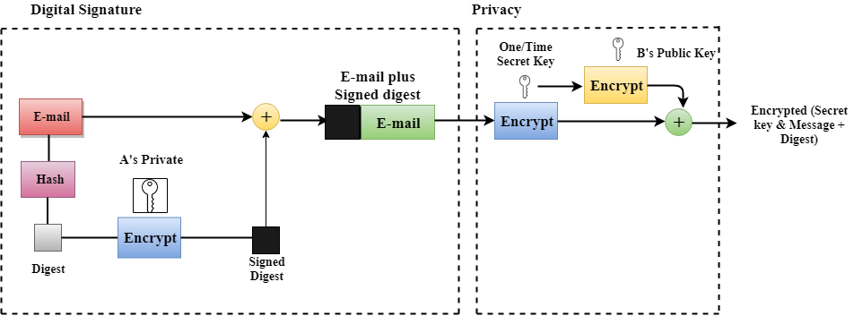

Slide 33
PGP
Disadvantages of PGP Encryption
The Administration is difficult
Compatibility issues
Complexity
No recovery

Slide 34
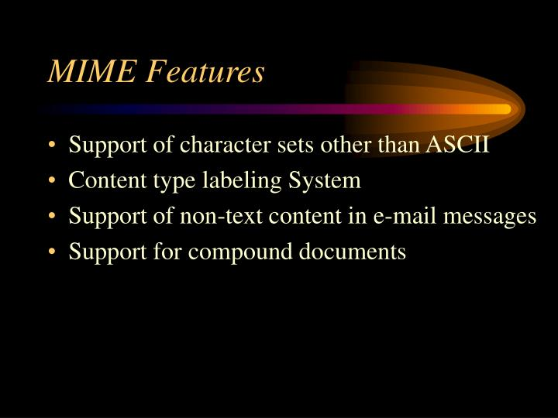
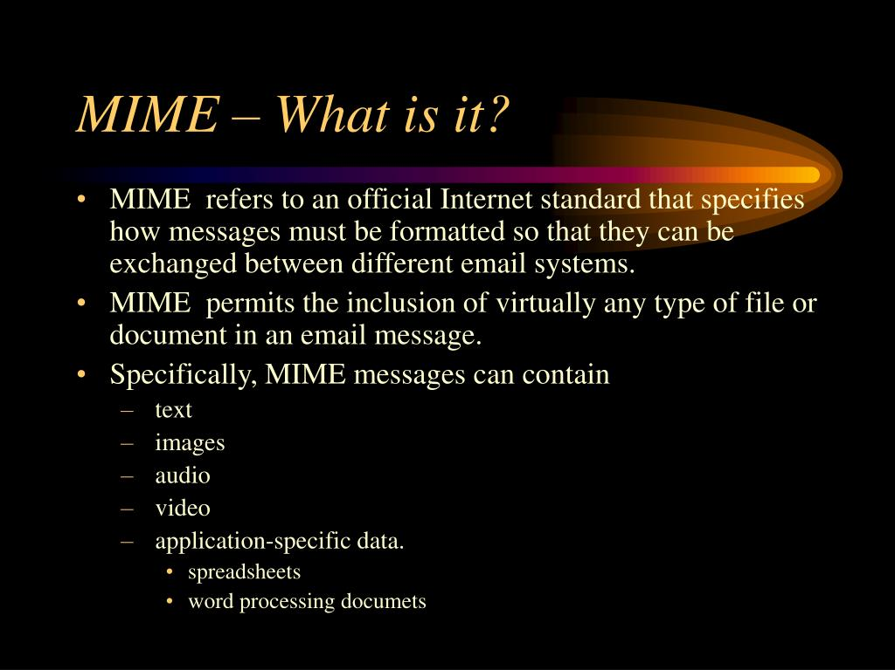
MIME

Slide 35
S/MIME
Secure/Multipurpose Internet Mail Extension (S/MIME) is an industry-standard for email encryption and signature that is commonly used by businesses to improve email security. S/MIME is supported by the majority of corporate email clients.
S/MIME encrypts and digitally signs emails to verify that they are verified and that their contents have not been tampered with.
S/MIME works based on asymmetric encryption. This means that there is a set of keys involved to encrypt and decrypt an email.
An S/MIME certificate is installed on the email clients of both the recipient and the sender. When an email is sent, the sender encrypts the email using the recipient's public key and the recipient decrypts the email using the private key. S/MIME also attaches a digital signature to an email. This ensures that the sender is authorized to send emails from a certain domain.

Slide 36
S/MIME
You receive a slew of cryptographic security features when you use an S/MIME certificate for email apps.
Authentication − It refers to the verification of a computer user's or a website's identity.
Message consistency − This is a guarantee that the message's contents and data have not been tampered with. The message's secrecy is crucial. The decryption procedure entails checking the message's original contents and guaranteeing that they have not been altered.
Use of digital signatures that invoke non-repudiation − This is a circumstance in which the original sender's identity and digital signatures are validated so that there is no doubt about it.
Protection of personal information − A data breach cannot be caused by an unintentional third party.
Encryption is used to protect data − It relates to the procedures described above, in which data security is ensured by a mix of public and private keys representing asymmetric cryptography.

